Slide 1

Yelp.com Reviews Text Mining & Analysis
Course: BIA 686 WS
Department: Business Intelligence and Analytics (BIA)
Presented By: Saketh Patibandla
ID: 10413333
Instructor: Prof. Christopher Asakiewicz
Final Project Presentation Deck

Slide 2
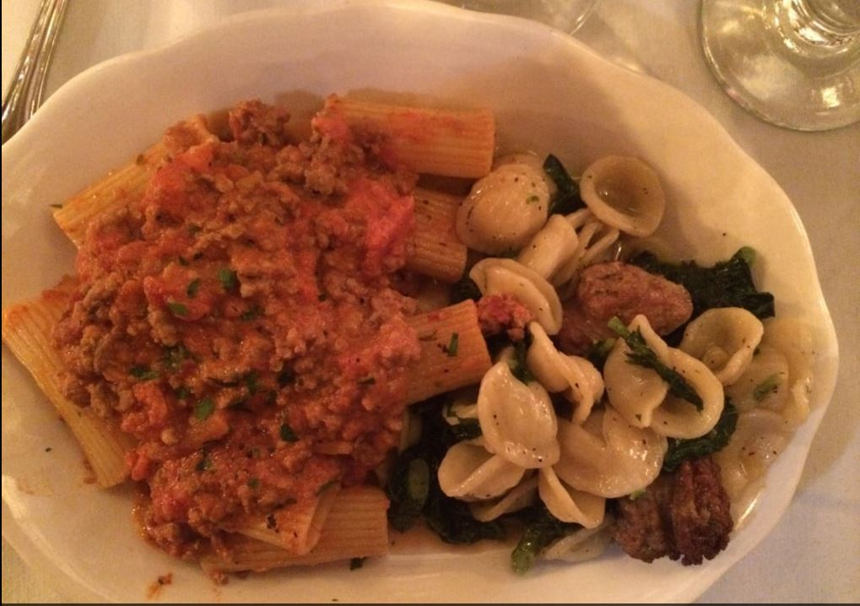
Introduction
Yelp.com is a famous site which consists of a category of restaurants.
A major factor for popularity is customer reviews written by public on various conditions that they experience based on identification, service, quality and other entities of the restaurant.
Customer Reviews consist of two items, star ratings (1-5) and textual reviews.

Slide 3
Problem:
There currently exists no automatic medium to govern the restaurants and analyze them based on the reviews written by customers.
A creation of an app makes it easy for regulatory board on Yelp.com to comment and generate feedback based on the sentiments (emotions) generated by the customers in their reviews.

Slide 4
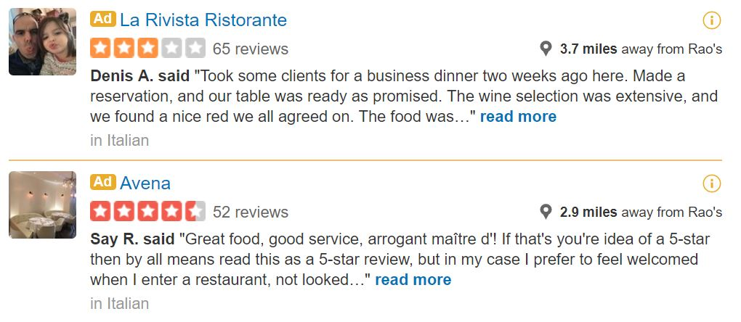
Data:
The data is scraped from top 100 restaurants in New York city in each Price Tier Category from Yelp.com
Some examples of these restaurants are:
21 Greenpoint, Agern, Jane, Raos, Grand Banks, Nobu 57, Naya Express
Reviews have been scraped individually from the web and have been collaborated into a single file consisting of 247,232 words.

Slide 5
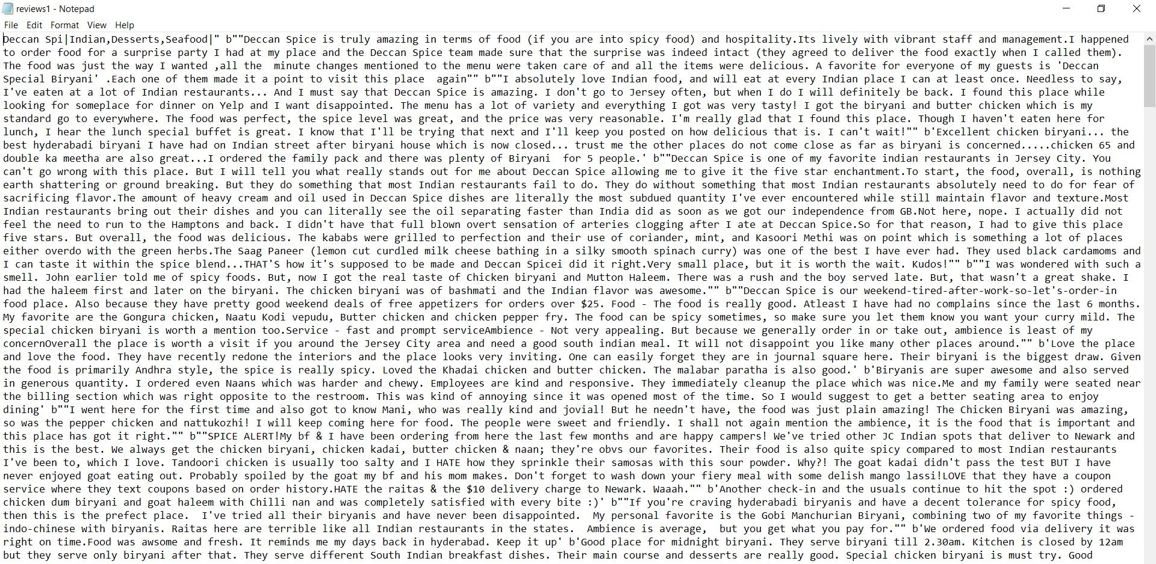
Data: (File example for an Indian Restaurant)

Slide 6
Approach to solution:
This problem is approached in several methods to analyze statistically and textually. Let us look at them carefully.
The following have been created with the application to demonstrate a textual analysis on the data before data cleaning:
Wordcloud (1-300 words) to check word frequency graphically.
Frequency Bar (Generates the most frequent words with frequency to analyze the most and the least frequent words dynamically with number of ocurances.
Sentiment Analysis (Positive, Negative and Neutral Analysis) of data based on all the words present.
Let us look at the data functionality prior to handling and manipulating data from outliers (in this case stopwords/numbers/nouns etc)

Slide 7
R Shiny:
R shiny is an application development tool in R to develop web based applications.
It has two major components.
UI.R – It controls the front end of the application (how the application looks to the user and the program to visually demonstrate and play with the data).
Server.R – It is the back end feature of the application and all the functionality occurs in the program controlled by this segment.
Shiny R is used to create our application as the review administrator on Yelp.com might not be technically sound would graphically like to analyze data from reviews.

Slide 8
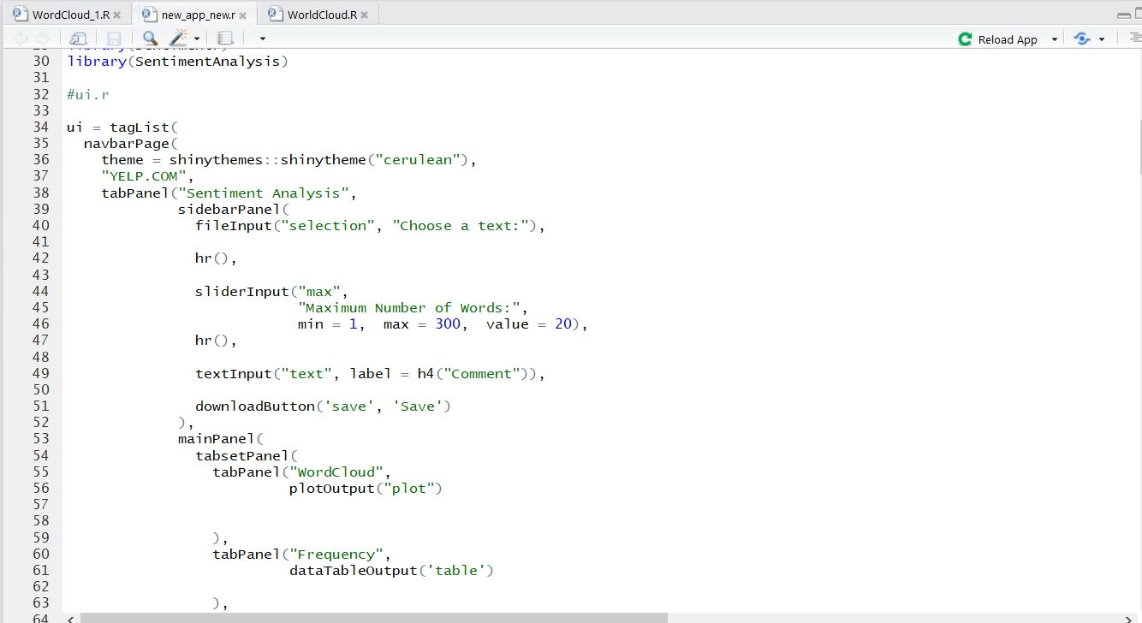
R Shiny: (A snippet of the program given below)

Slide 9
Feature Discussion:
Now, all the features from the application will be discussed in the following pages describing impacts and the result will be analyzed in the following based on the observations from the analysis.
The text file is input into the application initially using the browse command.
Once the text file is uploaded into the application, all features appear and can be analyzed based on the requirement from that restaurant.
Let us discuss the Indian restaurant that was chosen to get some insights.

Slide 10
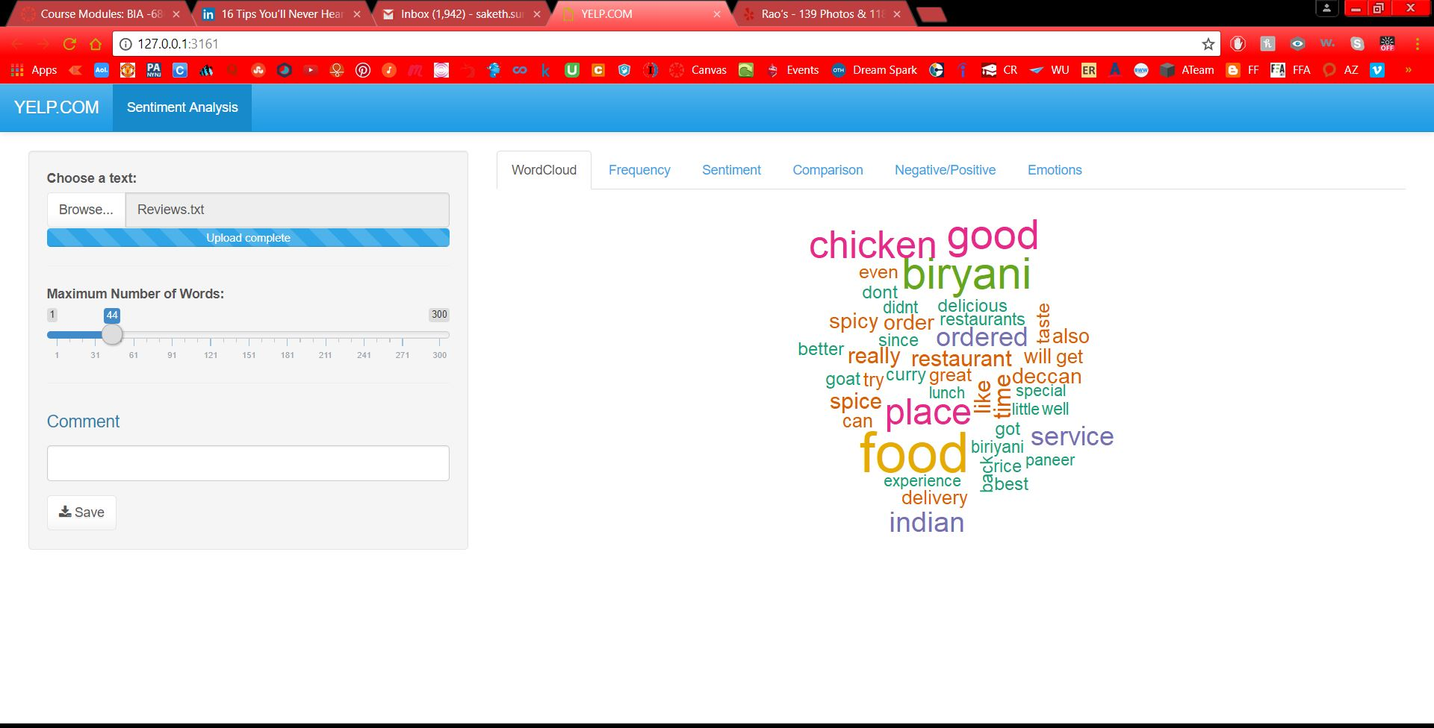
Analysis 1: Generating a word Cloud for the text based on number of words filter
44 words have been chosen to make the wordcloud.
Words like chicken, biryani appear which are good targets to improve business.
Since this is before removing the stop words, we cannot get much insight on reviews.

Slide 11
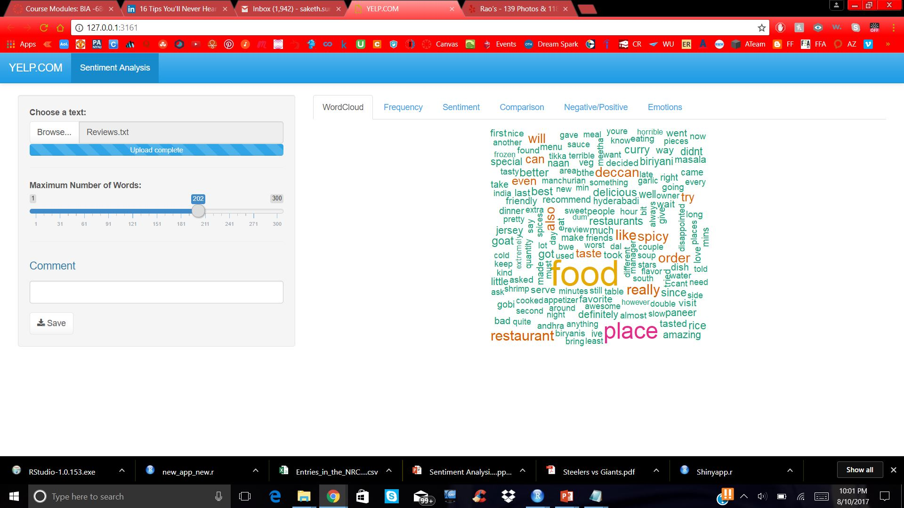
Analysis 1: Generating a word Cloud for the text based on number of words filter
202 words have been chosen to make the wordcloud.
Words like spicy appear which provides deeper insight and a dive into the dataset.
Since this is before removing the stop words, we cannot get much insight on reviews.

Slide 12
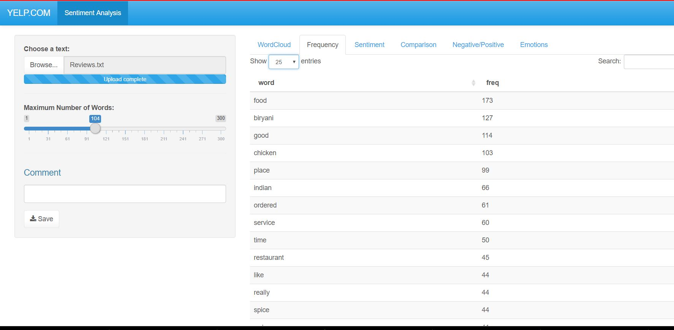
Analysis 2: Frequency and number based analysis
25 entries exist on this page. (It can be selected with options of 10/25/50/100)
Food has occurred 127 times.
We can select in reverse order to see the least popular food and analyze on that.

Slide 13
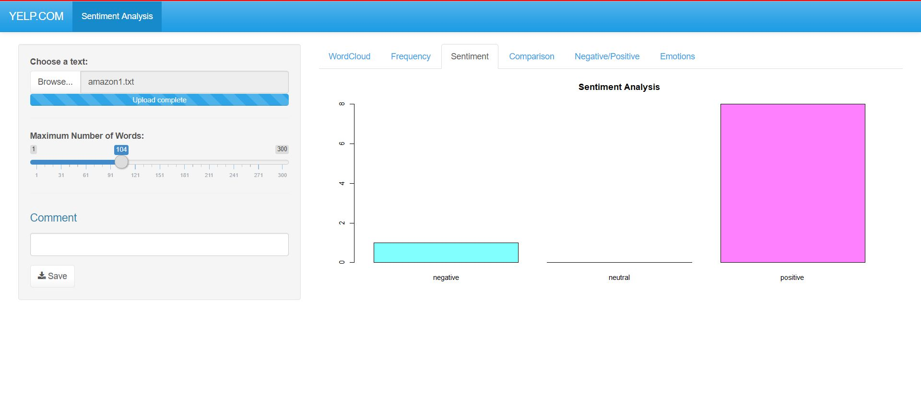
Analysis 3: Positive, Negative & Neutral Sentiments
This analysis is performed using a Sentiment Analysis Library to include neutral words before cleaning up stopwords.
This helps in preliminary analysis and is helpful to get an understanding of how the actual analysis is shaping up.

Slide 14
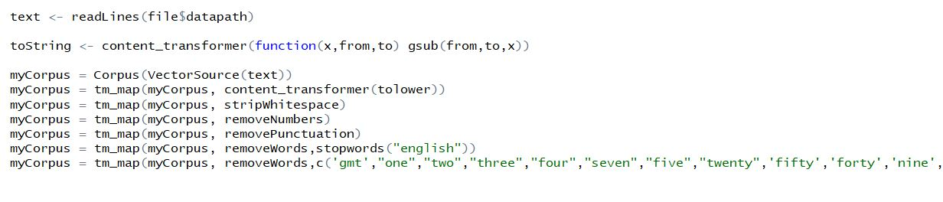
Data Cleaning: Removing Stop Words, Numbers and nouns
Now, to perform the rest of the analysis we remove unnecessary words.

Slide 15
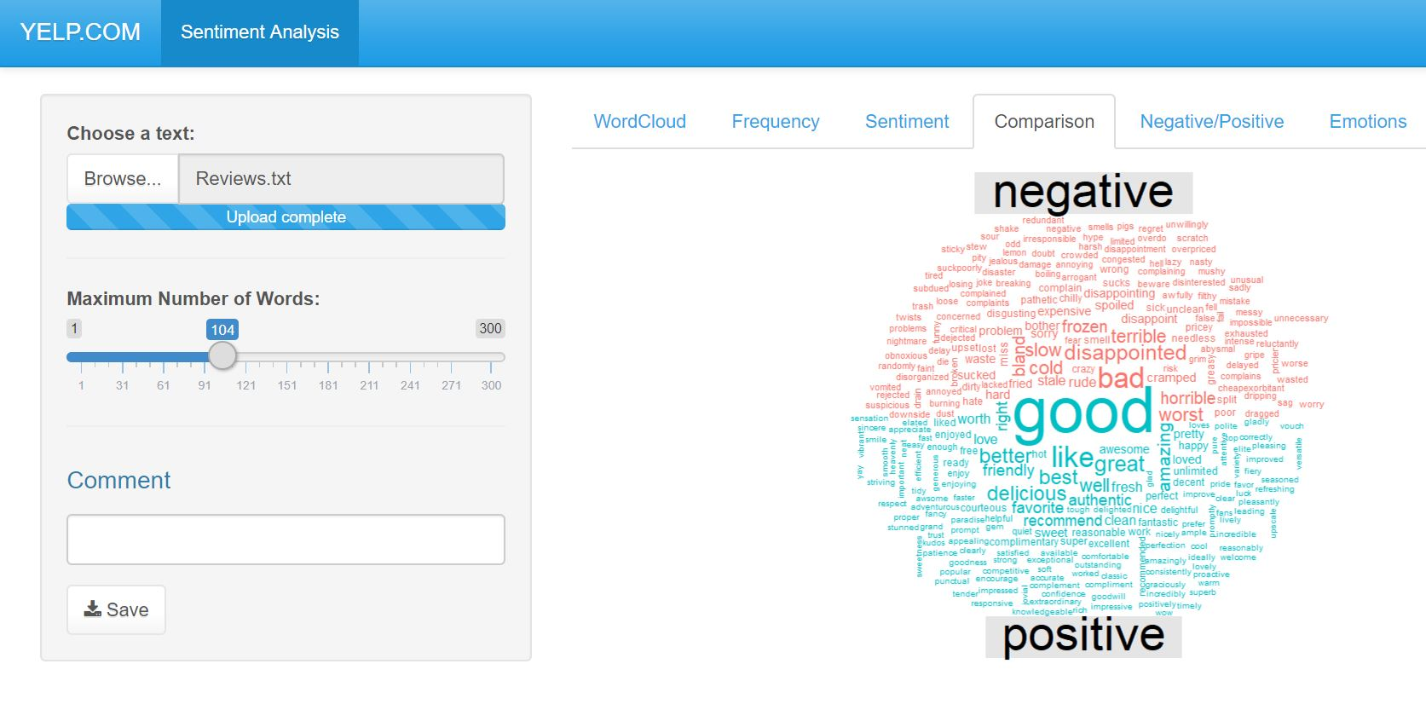
Analysis 4: Positive, Negative & Neutral Sentiments (BING)
This analysis describes a comparison study with a split wordcloud that gives insights using Bing Library.
Bing Library distributes the world cloud into negative and positive words which brings us into our next topic of sentiments.

Slide 16
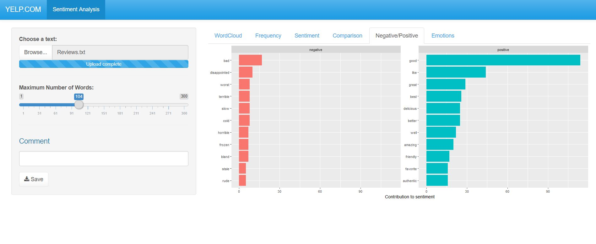
Analysis 5: Positive, Negative Word Analysis (NRC)
Using the NRC (word emotion lexicon), the positive and negative words are classified graphically based on the number of times repeated and whether they are positive or negative.
This is the result of the positive/negative analysis performed by the BING library with explanation.

Slide 17
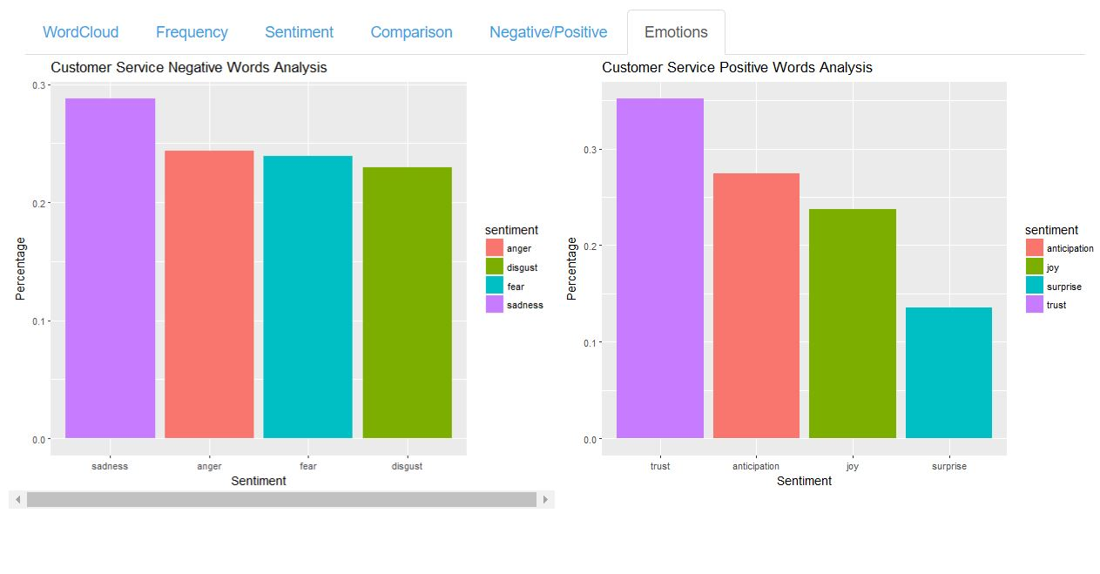
Analysis 6: Emotion Analysis (Positive/Negative)
Using the NRC (word emotion lexicon), the emotions of positive and negative sentiments are classified into 4 categories of sadness, anger, fear and disgust for negative words.
Sadness leads with 28%.
Similarly for positive emotions, it is categorized into anticipation, joy, surprise and trust.
Trust leads with 35%.

Slide 18
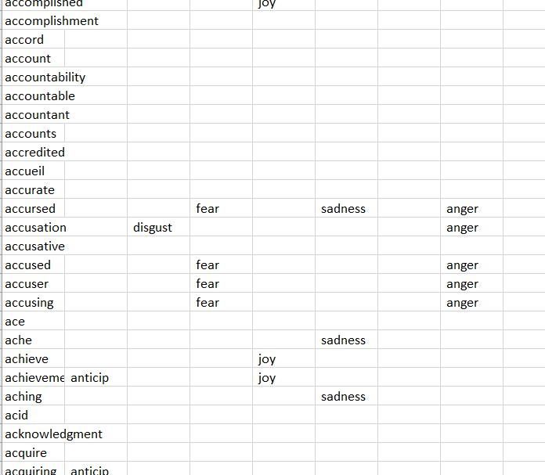
Analysis 6: NRC Library Categorization (Of emotions)
A spreadsheet is given below to show categorization of words into emotion sentiments, this is the official method used to determine the emotions percentage in the previous page.

Slide 19
Result & Feedback
Now, we can obtain the following results from the reviews:
Positive leads as the sentiment with 8 sentences involving positive phrases.
Trust is the best emotion with the highest percentage of involvement.
Good and Like are the words that have been used the most and can be seen in the 5th analysis.
Now, the board can make a positive comment and can boost it with their supervisor.

Slide 20
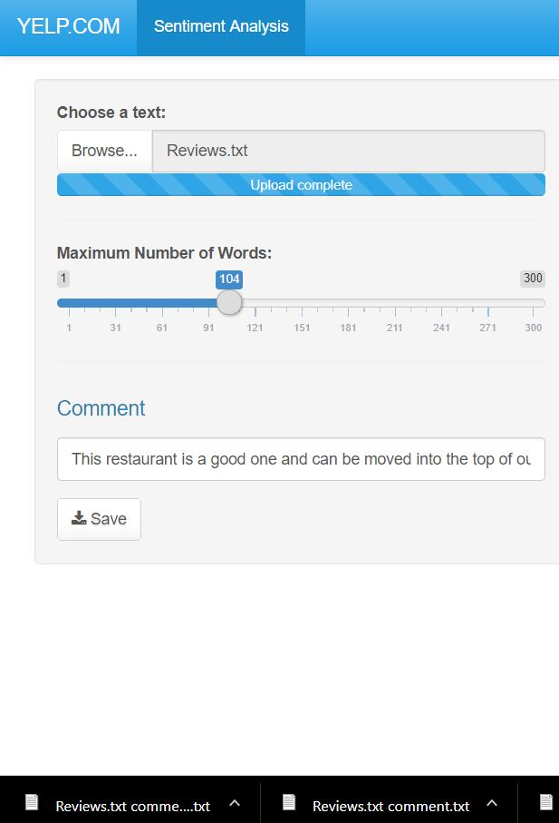
Result & Feedback (cont)
The information has been typed in the comment box and been saved to send an email communication.
This will be communicated to push the restaurant up the chain as it provides good business for Yelp/ Restaurant and satisfaction to the customer.

Slide 21
Improvement and Next Steps:
This could be launched to be performing a more dynamic visualization. (To move sentiments and emotions based on toggle bar)
The data could be analyzed better for neutral categories to determine whether it actually makes sense.
The feedback functionality could directly exist to send out an email to the support team to specify instructions.
The possibility of hosting it on the web for an application will be the next step to try.

Slide 22
THANK YOU

